Slide 1

Unit 4 Database Management System

Slide 2
Syllabus
Introduction to database
Database System
Database Management System
Database System Architectures
Database Applications
Introduction to Data Warehousing, Data mining and BigData

Slide 3
Data & Information
Data is collection of raw facts typically about physical phenomena or business transactions.
Data can be in any form-numerical, textual, graphical, image, sound, video etc.
For example of data would be the marks obtained by students in different subjects.
Information is defined as refined or processed data that has been transformed into meaningful and useful form for specific users.
For example, after processing the marks obtained by student it transformed into information, which is meaningful and from which we can decide which student stood first, second and so forth. Information comes from data and takes the form of table, graphs, diagrams etc.

Slide 4
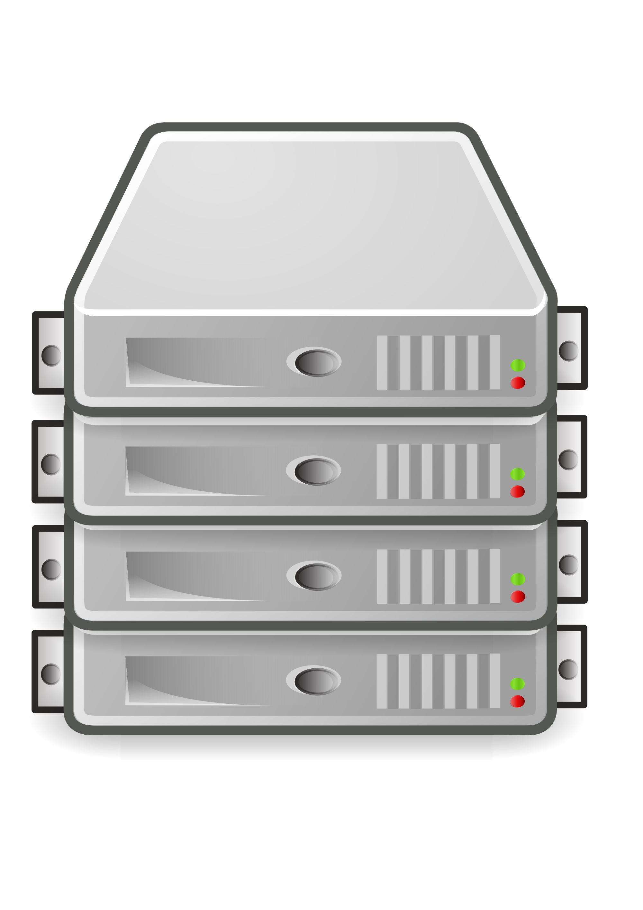
Database:
A database is an organized collection of interrelated data and contains information relevant to an enterprise.
The database is also called the repository or container for a collection of data files.
For example, telephone directory
Database system: It is a collection of Database and DBMS.

Slide 5
Characteristics of data in database:
The data in a database should have the following features:
Shared: Data should be sharable among different users and applications.
Persistence: Data should exist permanently in the database. Changes in the database must not be lost because of any failure.
Validity/Integrity/Correctness: It should maintain the integrity so that there is always correct data in the database.
Security: Data should be protected from unauthorized access.

Slide 6
Non-redundancy: Data should not be repeated.
Consistency: A consistent state of the database satisfies all the constraints specified in the database. Data in a database is consistent if any changes in the database take the database from one consistent state to another.

Slide 7
Database Management System:
A Database Management System (DBMS) is a collection of interrelated data and the set of programs to access those data. The primary goal of a DBMS is to provide a way to store and retrieve database information that is both convenient and efficient.
Some common examples of the DBMS software are Oracle, Sybase, Microsoft SQL Server, DB2, MySQL, Postgres, Dbase, Ms-Access etc.
For example, in a computer system, the checking account processing system, the auto loan system and the saving accounts would have a common database. This database based approach to data processing is shown in fig below

Slide 8
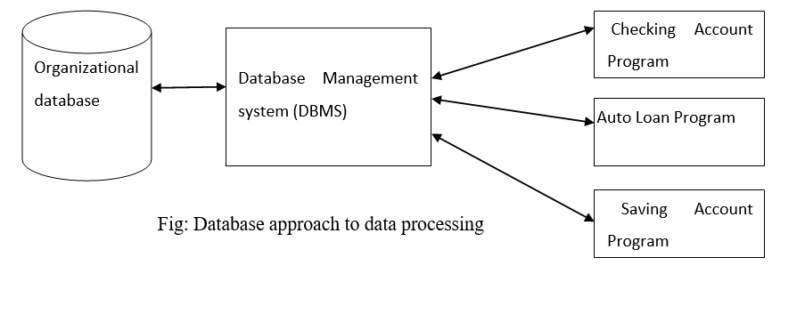

Slide 9
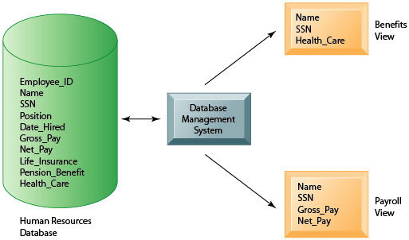
Example:

Slide 10
Objective of DBMS
The DBMS is able
To provide large space or storage for relevant data.
To provide easy access to the data for the users.
To provide quick response to user request for any data.
To remove duplicate (redundant) data.
To update the database latest modification immediately.
To allow the multiple users to be active at one time.
As the organization grows, DBMS allows the growth of the database system.
To provide maximum protection to data from any physical damage and unauthorized access.

Slide 11
Components of Database System
Users
Application Programs
End Users
Data Administrator
Hardware
Software
Database Management System
Application Software
User Interface
Data

Slide 12
Applications of DBMS:
Databases form an essential part of almost all enterprises. Some database applications are given below:
Banking: For customer information and all transactions
Airlines: For reservations and schedules information
Universities: For the student information, course registration and grades
Credit and transaction: For purchase credit cards and generates monthly statement
Telecommunication: Keeping records of all the telephone calls, generating monthly bills etc.
Finance: For storing financial information
Sales: For customers, products and purchases information
Manufacturing: For tracking production, inventory, orders, supply chain management
Human resources: For storing the information about employee records, salaries, tax deductions

Slide 13
Disadvantages of DBMS
Problem associated with centralization: Centralization increases the security problems.
Cost of software: Today’s there are several software which are very costly. Hence from economic point of view it is the drawback.
Cost of hardware: To support various software some upgraded hardware components are needed. Hence from economic point of view it is the drawback.
Complexity of backup and recovery: DBMS provides the centralization of the data, which requires the adequate backups of data.
Overhead for providing generality, security, recovery, integrity, and concurrency control.

Slide 14
Question 1:
Define Data, Information, Database and Database Management System(DBMS). And also Explain why DBMS is so important nowadays? You can explain with examples.

Slide 15
Database System Architectures
Database architectures refers to the overall design and structure of a database system, outlining how it is organized and how its components interact.
Database system architectures can be broadly categorized into three main types:
On the basis of geographical location:
Centralized Database Architecture
Decentralized Database Architecture
On the basis of functional structure:
1-Tier Architecture
2-Tier Architecture
3-Tier Architecture

Slide 16
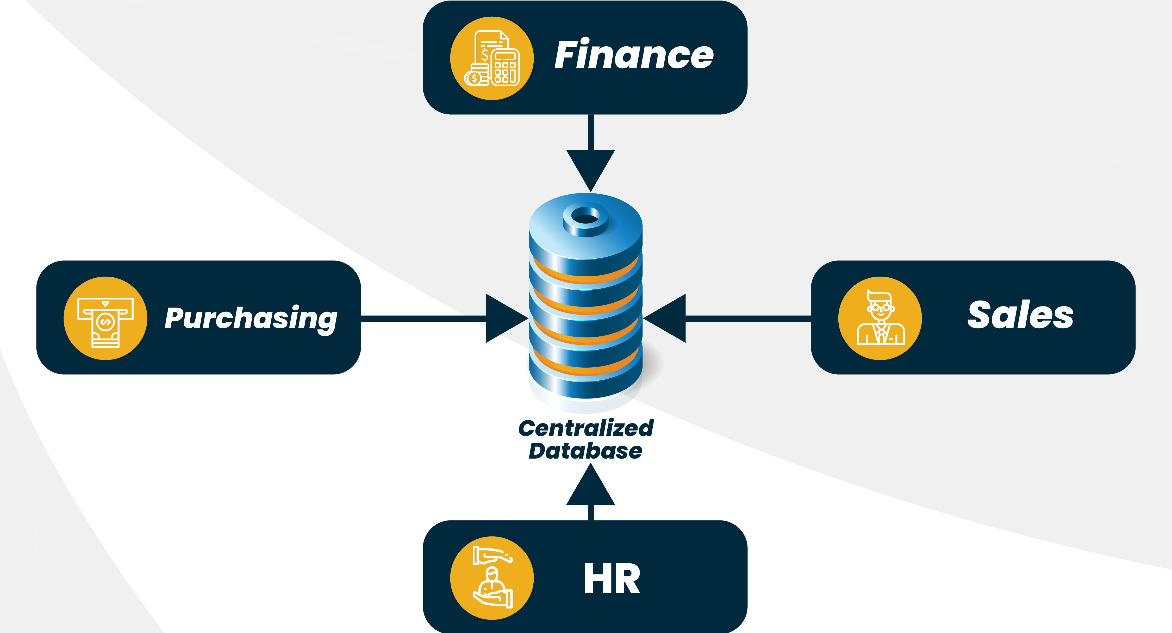
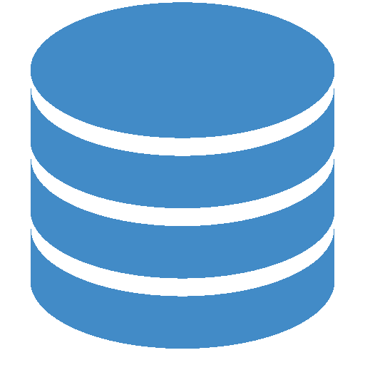
Centralized Database Architecture
Data are stored in single location and every user at different location can access the central server .
Centralized database architecture combines everything into single system including DBMS software, hardware, application programs and user interface processing software

Slide 17
Centralized Database Architecture
Advantages:
Easier to access and coordinate data
It has very minimal data redundancy since all data is stored at single place
It is cheaper in comparison to all other databases available
Disadvantages:
It will reduce the local accountability
The data traffic in case of centralized database is more
If any kind of system failure occurs at centralized system then entire data will be destroyed
Large data storage needed

Slide 18
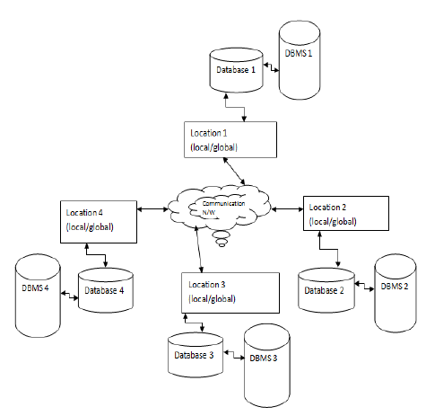
Decentralized Database Architecture
Database is stored at more than one place and more than one computer then it is called distributed database. Different users can use different DBMS, different data structure and each site controls its own data, security , logging and recovery mechanisms
In other words, distributed database is a collection of multiple logically interrelated databases distributed over a computer network and distributed database management system is the software that manages a distributed database while making the distributed transparent to the user. The

Slide 19
Decentralized Database Architecture
Advantages:
Local control of local data
Lower cost
Modularity
Ability to share data
Better response time
Disadvantages:
Technical problem of connecting dissimilar machine
Need for sophisticated communication system
Data integrity and security problem
Lack of professional support.

Slide 20
1 tier architecture(Standalone)
DBMS and application software are situated on single system.
Simple easy to manage for small scale applications only

Slide 21
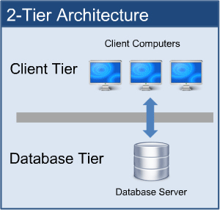
2 tier architecture(Client Server Architecture)
Database system is located at Server side and DBMS is located at client ends.
The 2-Tier architecture is same as basic client-server. In the two-tier architecture, applications on the client end can directly communicate with the database at the server side. For this interaction, API's like: ODBC, JDBC are used.
The user interfaces and application programs are run on the client-side.
The server side is responsible to provide the functionalities like: query processing and transaction management.
To communicate with the DBMS, client-side application establishes a connection with the server side.

Slide 22
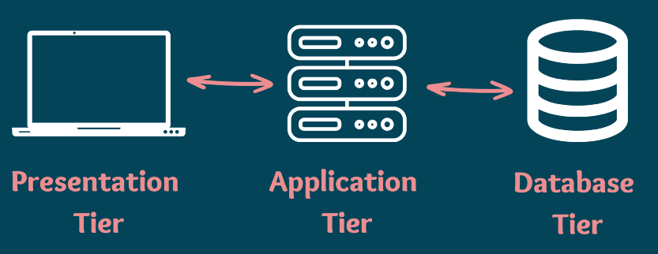
3 tier architecture

Slide 23
Database users and administrators
Database users:
Users are differentiated by the way they expect to interact with the system. There are four different types of database-system users:
Naive Users: They are unsophisticated users who interact with the system by invoking one of the application programs that have been written previously. For example: a bank teller who needs to transfer $50 from account A to account B invokes a program called transfer.
Application programmers: They are computer professionals who write application programs. Application programmers can choose any tools to develop user interface.
Sophisticated users: They interact with the system without writing programs. They form their requests in a database query language.
Specialized users: They are sophisticated users who write specialized database applications that do not fit into the traditional data-processing framework. Among these applications are computer-aided design systems, knowledge base and expert systems, systems that store data with complex data types (graphics data and audio data), and environment-modeling systems.

Slide 24
Database Administrator:
The person who has such central control over the system is called the database administrator (DBA). The function of the DBA includes the following:
Schema definition: The DBA creates the original database schema by writing a set of definitions that is translated by the DDL compiler to a set of tables that is stored permanently in the data dictionary.
Granting the authorization of data access: The granting of different types of privileges to the database users so that all the users are not able to all data.
Routine maintenance: Routine maintenance includes periodic backing up the database, either onto tapes or onto remote servers, to prevent loss of data in case of disasters such as flooding, Ensuring that enough free disk space is available for normal operations, and upgrading disk space as required etc.

Slide 25
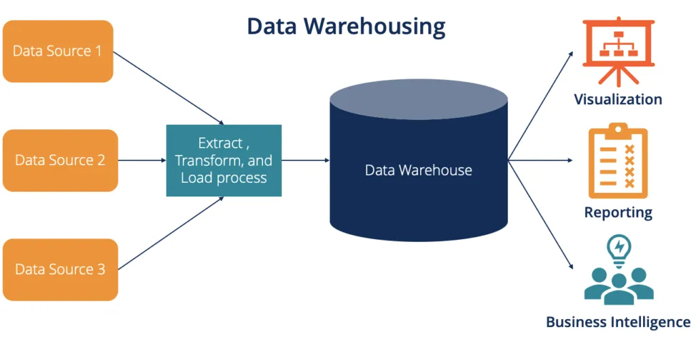
Data Warehouse
A Data warehouse is a centralized repository for storing and managing large amounts of structured and semi-structured data. The purpose of a data warehouse is to provide a single, integrated view of an organization's data to support decision-making and analysis.

Slide 26
Data warehousing
Components of Data warehousing
Central database
ETL(Extract, transform, load) tools
Metadata
Access tools

Slide 27
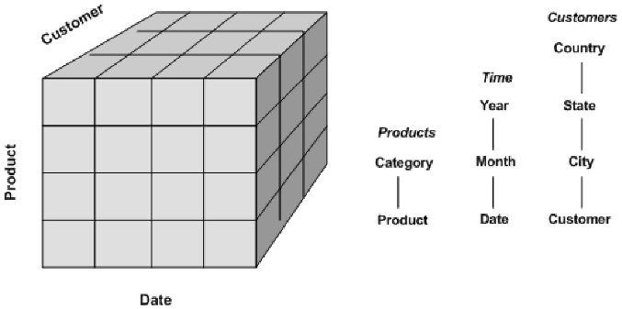
Data cube

Slide 28
Characteristics of Data Warehouse
Subject Oriented: Data to be organized towards the major subject areas of organization i.e. an insurance company oriented data by customer, premium and claims etc.
Integrated: The way data is extracted and transformed is uniform, regardless of the original source.
Non-volatile: A data warehouse is not updated in real time. It is periodically updated via the uploading od data, protecting it form the influence of momentary change.
Time-Variant: Data is organized via time-periods(weekly, monthly, annually, etc.)

Slide 29
Data mining
Data mining is the process of discovering patterns and knowledge from large amounts of data. It involves the use of algorithms and statistical models to extract insights and make predictions about data. The goal of data mining is to extract information from data and transform it into an understandable structure for further use.
Advantages
It is tool used for searching valuable business information in a large database.
Automated prediction of trends and behaviors
Automated discovery of previously unknown patterns: It can identify hidden patterns like fraudulent credit card transaction.
Data mining scans full database variable rather than selecting limited variables.

Slide 30
Big Data
Big data is high volume, high velocity and/or high variety information assets that demand cost effective, innovative forms of information processing that enable enhanced insight, decision making , and automation.
Volume: Large amount of data- Terabyte to zettabyte
Velocity: Large amount of data from transactions with high refresh rate, time to act on the basis of these data streams will often be very short 30KB to 30GBPS
Variety: Data from different data sources(enterprise data, experimental/observational data, social media), data types( structured, unstructured, and semi structured)

Slide 31
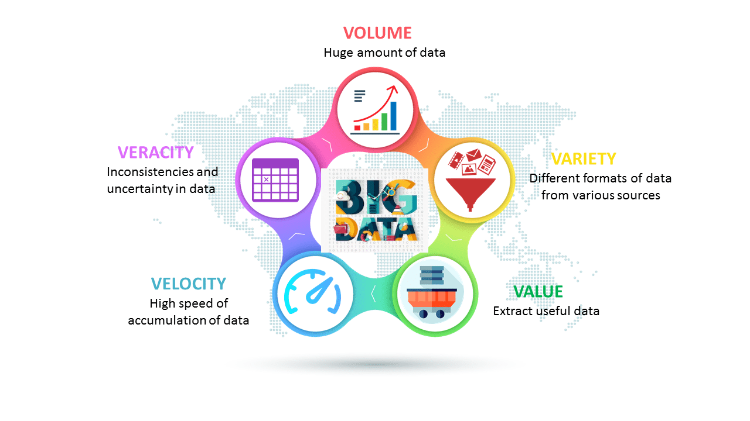
Big Data

Slide 32
Question
Write short notes on:
Database Users
Database Administrator
Database system architecture
Data warehouse
Data mining
Bigdata

